Slide 1
Work Progress
By: Abdur Rehman

Slide 2
Recurrent Neural Network from Scratch in Python
Step I: Data Preparation
The data I had before was in the Dataframe format and had to be changed to NumPy Arrays for the implementation of Neural Networks in Python
%pylab inline
import math
import pandas as pd
#Input
df = pd.read_excel (r'C:/Users/Abdur Rehman/Input_CasADi_5000.xlsx’)
input_signal = df["input_signal"]
input_signal = input_signal.to_numpy().reshape(5000, 1)
input_signal = input_signal.reshape(100,50,1)
#Output (Single State)
df1 = pd.read_excel (r'C:/Users/Abdur Rehman/Output_CasADi_5000.xlsx’)
Output_signal = df1[['State 1']]
Output_signal= Output_signal[:100]
X = input_signal
Y = Output_signal

Slide 3
Step II: Setting Validation Data
Output_signal_Val= Output_signal[:50]
Input_signal_Val= input_signal[:50]
X_val = Input_signal_Val
Y_val = Output_signal_Val
Step III: Create the Architecture for our RNN model
learning_rate = 0.0001
nepoch = 25
T = 50 # length of sequence
hidden_dim = 100
output_dim = 1
bptt_truncate = 5
min_clip_value = -10
max_clip_value = 10

Slide 4
Step IV: Define the weights of the network
U = np.random.uniform(0, 1, (hidden_dim, T))
W = np.random.uniform(0, 1, (hidden_dim, hidden_dim))
V = np.random.uniform(0, 1, (output_dim, hidden_dim))
Here,
U is the weight matrix for weights between input and hidden layers
V is the weight matrix for weights between hidden and output layers
W is the weight matrix for shared weights in the RNN layer (hidden layer)
Step V: Define the activation function, sigmoid
def sigmoid(x):
return 1 / (1 + np.exp(-x))
Step VI: Train the Model
The code was a bit long, so I will send it separately.

Slide 5
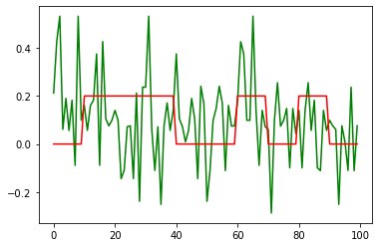
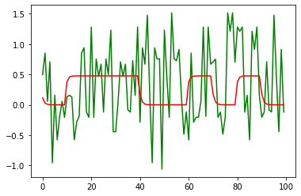
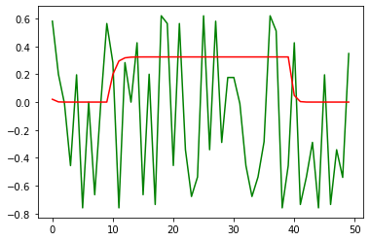
The Analysis
We will do a forward pass through the trained weights to get our predictions
Plotting these predictions alongside the actual values
State I
State II
State III

Slide 6
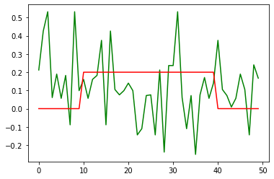
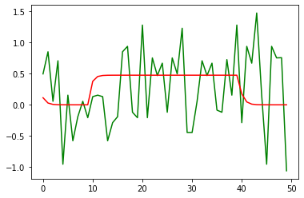
We will do a forward pass through with validation set:
State III
State III
State III

